Slide 1
Lecture 01

Slide 2
Contents
What is Programming?
Different approaches for Programming
Different Programming Languages
Difference between C,C++,Java
What is Java?
Features of Java
OO concepts
Sample Program
What is JDK?

Slide 3
What is Programming?
Programming is somewhat like working with building blocks.
The five basic elements in programming are:
  input: getting data and commands into the computer
  output: getting your results out of the computer
  arithmetic: performing mathematical calculations on your data
  conditional: testing to see if a condition is true or false
  looping: cycling through a set of instructions until some condition is met

Slide 4
What is Computer Programming?
Way of giving computers instructions about what they should do next.
These instructions are known as code, and computer programmers write code to solve problems or perform a task.
End goal is to create something:
  Anything from a web page or a piece of software or even just a pretty picture.
A computer program is a list of instructions that enable a computer to perform a specific task.
Computer programs can be written in high and low level language, depending on the task and the hardware being used.

Slide 5
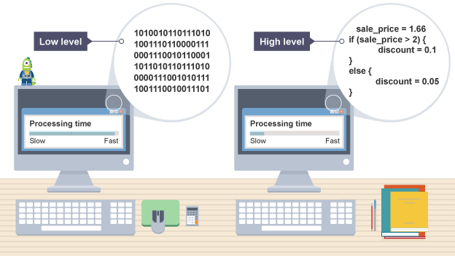
Difference between low level & high level

Slide 6
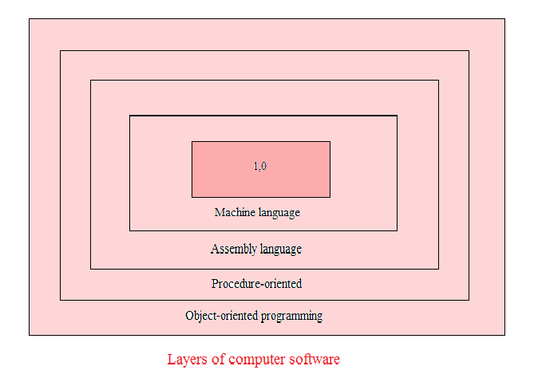
Difference between low level & high level

Slide 7
Approaches of Programming
Procedural Programming Approach
Structured Programming Approach
Modular Programming Approach
Object Oriented Programming Approach

Slide 8
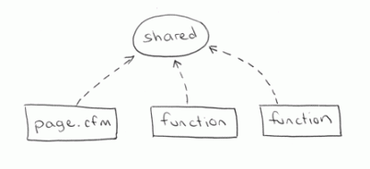
Procedural Programming Approach
Procedural Programming is a subset of structured programming, derived from structured programming, based on the concept of the procedure call.
Procedures, also known as routines, subroutines, or functions, simply contain a series of computational steps to be carried out.
  Software maintenance can be difficult and time consuming. Importance is given to data. Hard to reuse.
Example: ALGOL, COBOL, BASIC, Pascal, Fortran

Slide 9
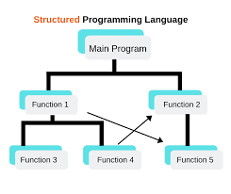
Structured Programming Approach
Its main purpose to enforce a logical structure on the program being written to make it more efficient and easier to understand and modify.
The structured programming language allows a programmer to code a program by dividing the whole program into smaller units or modules.
Structured programming is not suitable for the development of large programs and does not allow reusability of any set of codes.
E.g C

Slide 10
Procedural programming Vs Structured Programming
A procedural programming language consists of a set of procedure calls and a set of code fo each procedure. A structural programming language emphasizes on separating a program's data from its functionality.

Slide 11
Modular Programming Approach
When creating a modular system, instead of creating a monolithic application (where the smallest component is the whole), several smaller modules are written separately so when they are composed together, they construct the executable application program. Typically these are also compiled separately, via separate compilation, and then linked by a linker. A just-in-time compiler may perform some of this construction "on-the-fly" at run time.
In modular programming , each module perform logically discrete functions, interacting through well-defined interfaces.

Slide 12
Modular Programming Approach
Modular programming is the process of subdividing a computer program into separate sub-programs. A module is a separate software component.
It can often be used in a variety of applications and functions with other components of the system.
Some programs might have thousands or millions of lines and to manage such programs it becomes quite difficult as there might be too many of syntax errors or logical errors present in the program, so to manage such type of programs concept of modular programming approached.

Slide 13
Modular Programming Approach
Each sub-module contains something necessary to execute only one aspect of the desired functionality.
Modular programming emphasis on breaking of large programs into small problems to increase the maintainability, readability of the code and to make the program handy to make any changes in future or to correct the errors.
e.g. header files in C

Slide 14
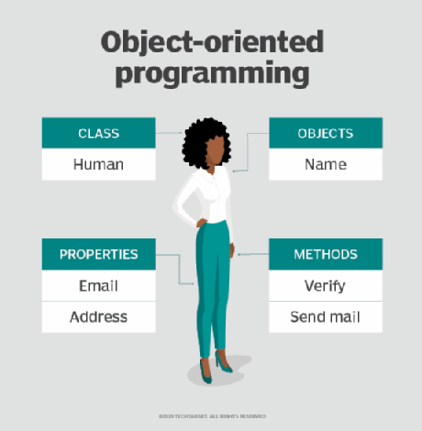
OO Programming Approach
Object-oriented programming (OOP) is a programming language model in which programs are organized around data, or objects, rather than functions.
An object can be defined as a data field that has unique attributes and behaviour.
Example: Java, Python, JavaScript, C++ etc.

Slide 15
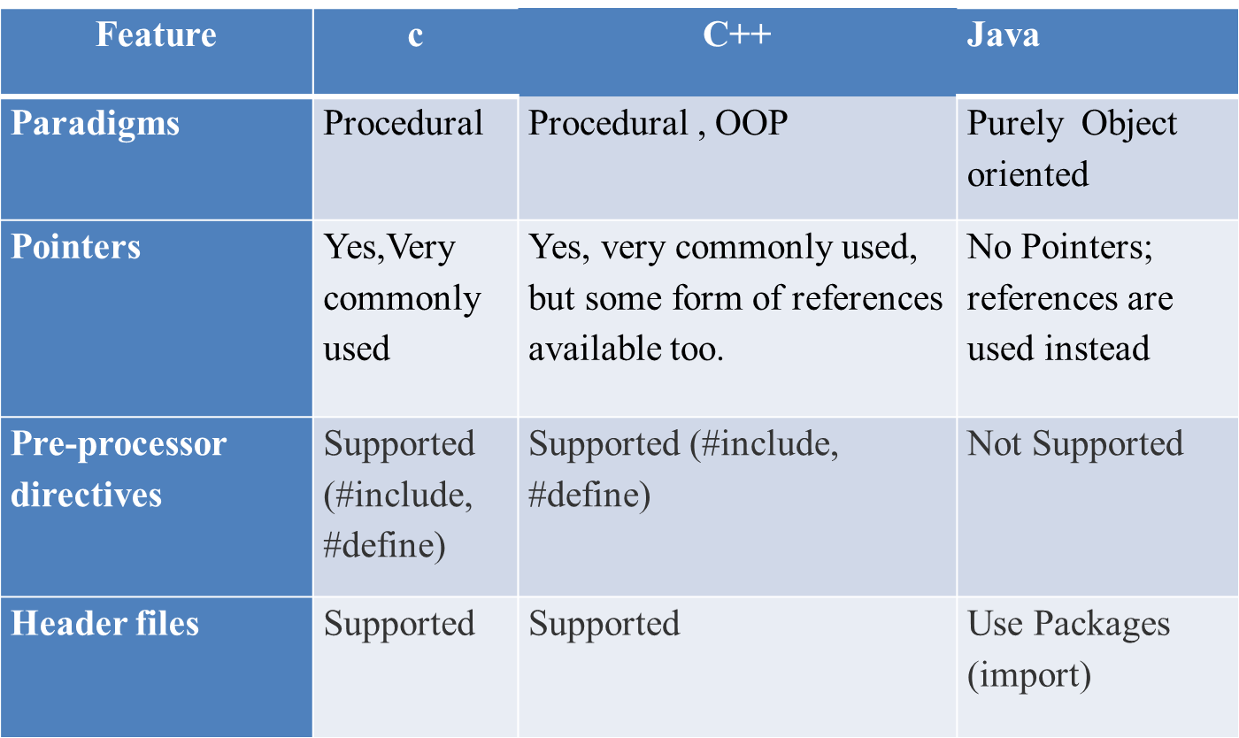
Difference Between C,C++,Java

Slide 16
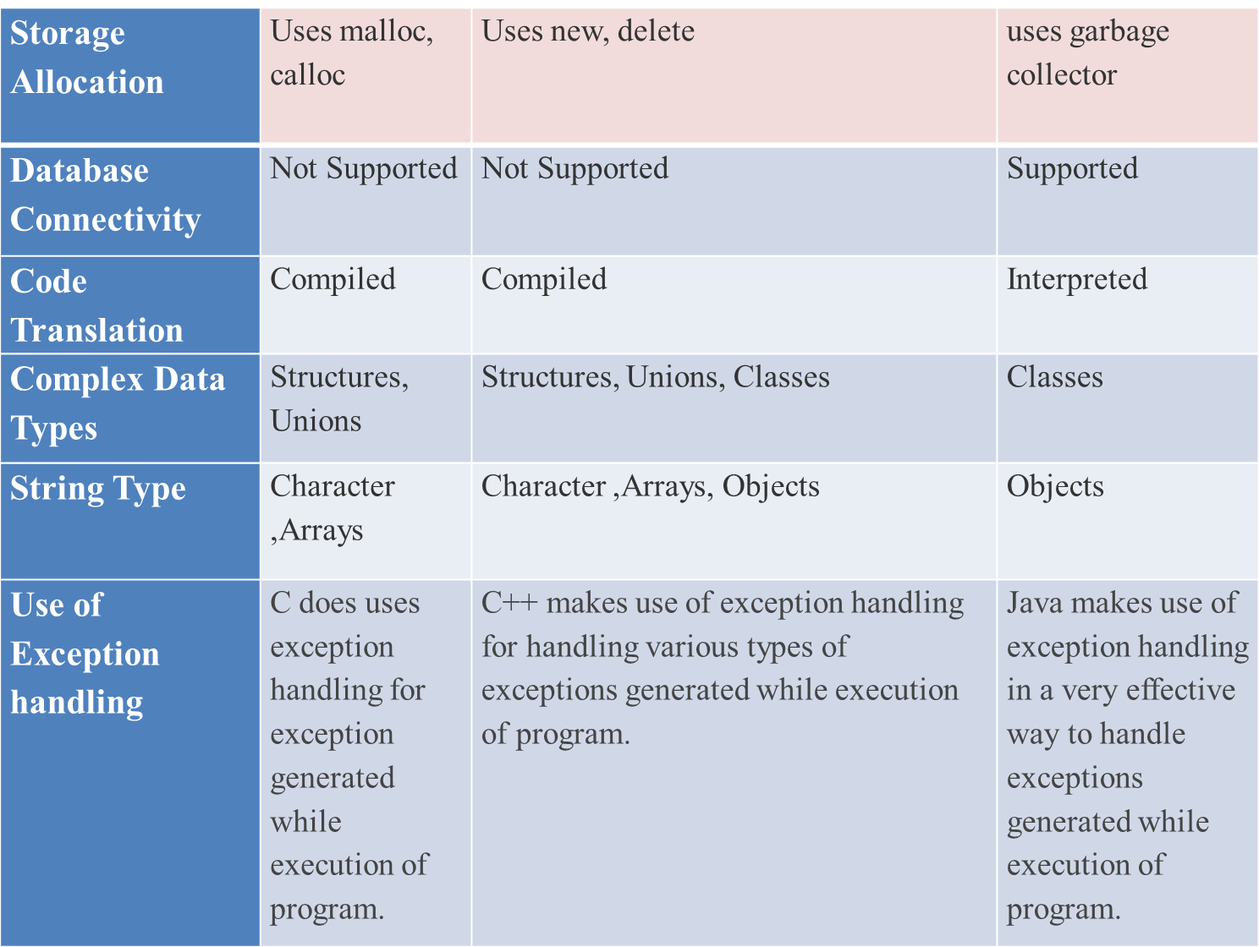

Slide 17
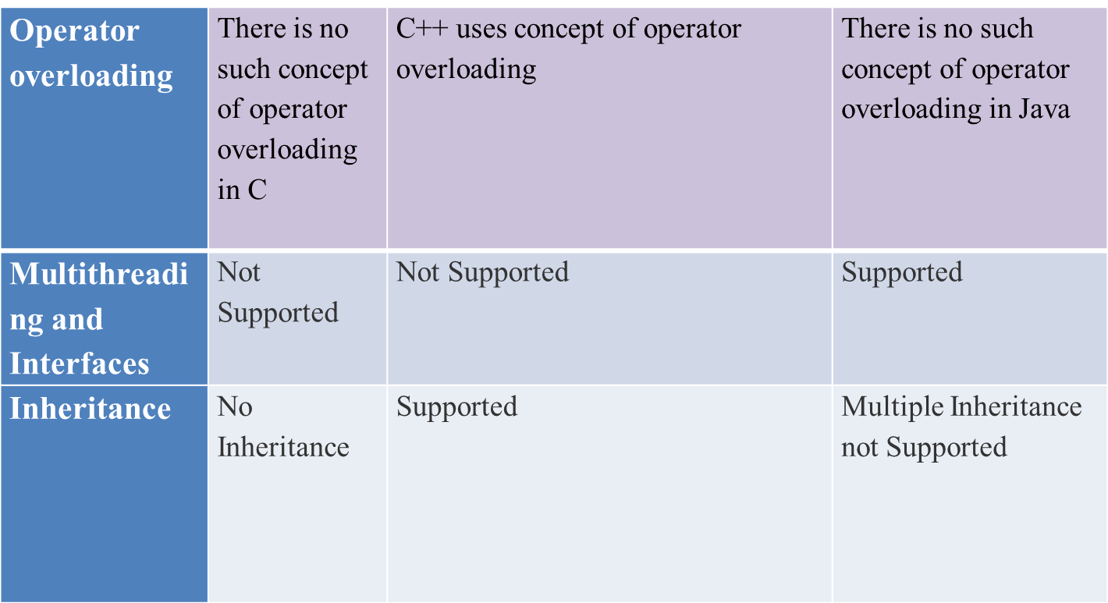

Slide 18
What is java ?
Java is a programming language.
Java is a high level, robust, object-oriented and secure programming language.
Platform: Any hardware or software environment in which a program runs, is known as a platform.
  It is object oriented programming program is composed of a collection objects that communicate with each other
  Named after coffee name Java. Previously named as Oak.
  Developed by James Gosling and grp by Sun Microsystems in 1995.

Slide 19
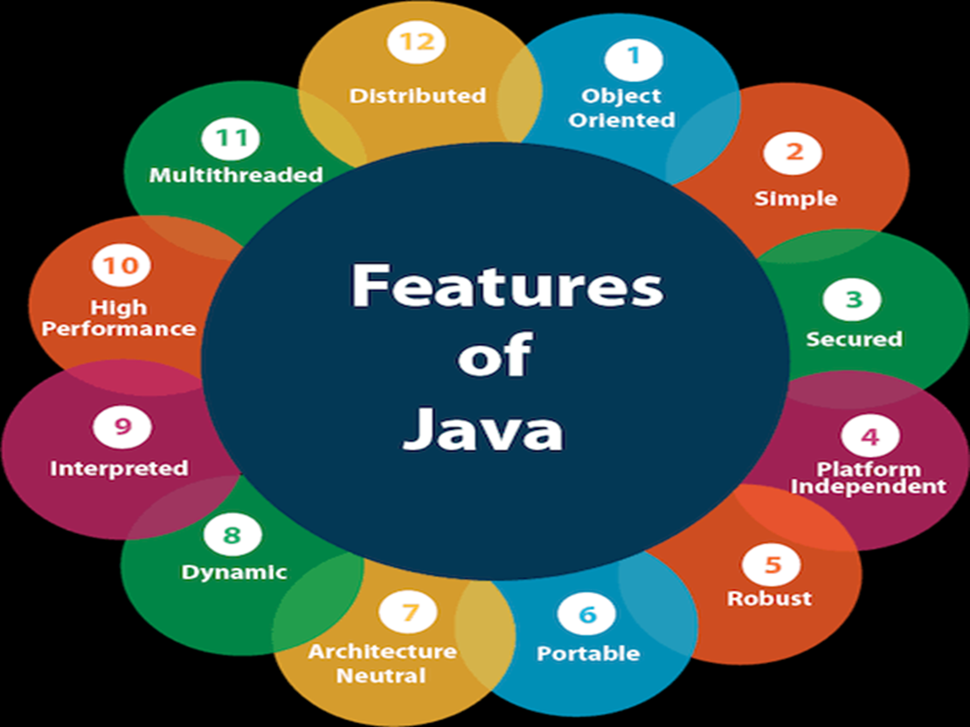
Features of java ?

Slide 20
Features of java ?
Simple
Object-Oriented
Portable
Platform independent
Secured
Robust
Architecture neutral
Interpreted
High Performance
Multithreaded
Distributed
Dynamic

Slide 21
Simple
Java is very easy to learn, and its syntax is simple, clean and easy to understand. According to Sun, Java language is a simple programming language because
Java syntax is based on C++ (so easier for programmers to learn it after C++).

Slide 22
Object Oriented
Java is an object-oriented programming language. Everything in Java is an object. Object-oriented means we organize our software as a combination of different types of objects that incorporates both data and behaviour.
Object-oriented programming (OOPs) is a methodology that simplifies software development and maintenance by providing some rules.
Basic concepts of OOPs are:
Object
Class
Inheritance
Polymorphism
Abstraction
Encapsulation

Slide 23
Portable
Java is portable because it facilitates you to carry the Java bytecode to any platform. It doesn't require any implementation.

Slide 24
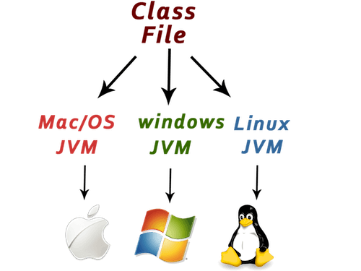
Platform Independent
Java is platform independent because it is different from other languages like C, C++, etc. which are compiled into platform specific machines
while Java is a write once, run anywhere language.

Slide 25
Secured
Java is best known for its security. With Java, we can develop virus-free systems. Java is secured because:
No explicit pointer
Java Programs run inside a virtual machine

Slide 26
Robust
Robust simply means strong. Java is robust because:
It uses strong memory management.
There is a lack of pointers that avoids security problems.
There are exception handling and the type checking mechanism in Java. All these points make Java robust.

Slide 27
Architecture neutral
Java is architecture neutral because there are no implementation dependent features, for example, the size of primitive types is fixed.

Slide 28
High Performance
Java is faster than other traditional interpreted programming languages because Java bytecode is "close" to native code. It is still a little bit slower than a compiled language (e.g., C++).
Multithreading enhances the overall speed of Java programs.

Slide 29
Distributed
Java is distributed because it facilitates users to create distributed applications in Java.

Slide 30
Multithreaded
A thread is like a separate program, executing concurrently. We can write Java programs that deal with many tasks at once by defining multiple threads.
The main advantage of multi-threading is that it doesn't occupy memory for each thread. It shares a common memory area. Threads are important for multi-media, Web applications, etc.

Slide 31
Dynamic
Java is a dynamic language. It supports dynamic loading of classes. It means classes are loaded on demand. It also supports functions from its native languages, i.e., C and C++.
Java supports dynamic compilation and automatic memory management (garbage collection)

Slide 32
Object oriented concepts
Class
Object
Inheritance
Polymorphism
Abstraction
Encapsulation
Message Passing

Slide 33
Objects and classes in Java
An object in Java is the physical as well as a logical entity, whereas, a class in Java is a logical entity only.
An entity that has state and behaviour is known as an object e.g., chair, bike, marker, pen, table, car, etc. An object has three characteristics:
State: represents the data (value) of an object.
Behaviour: represents the behaviour (functionality) of an object such as deposit, withdraw, etc.
Identity: An object identity is typically implemented via a unique ID. The value of the ID is not visible to the external user. However, it is used internally by the JVM to identify each object uniquely.

Slide 34
Objects in Java
An object is an instance of a class. A class is a template or blueprint from which objects are created. So, an object is the instance(result) of a class.
Object Definitions:
An object is a real-world entity.
An object is a runtime entity.
The object is an entity which has state and behavior.
The object is an instance of a class.

Slide 35
classes in Java
A class is a group of objects which have common properties. It is a template or blueprint from which objects are created. It is a logical entity. It can't be physical.
A class in Java can contain:
Fields
Methods
Constructors
Blocks
Nested class and interface

Slide 36
Inheritance in Java
Inheritance in Java is a mechanism in which one object acquires all the properties and behaviours of a parent object. It is an important part of OOPs (Object Oriented programming system).
The idea behind inheritance in Java is that you can create new classes that are built upon existing classes. When you inherit from an existing class, you can reuse methods and fields of the parent class. Moreover, you can add new methods and fields in your current class also.
Inheritance represents the IS-A relationship which is also known as a parent-child relationship.

Slide 37
Polymorphism in Java
Polymorphism in Java is a concept by which we can perform a single action in different ways. Polymorphism is derived from 2 Greek words: poly and morphs. The word "poly" means many and "morphs" means forms. So polymorphism means many forms.
E.g.Person
There are two types of polymorphism in Java: compile-time polymorphism and runtime polymorphism.
We can perform polymorphism in java by method overloading and method overriding.

Slide 38
Abstraction in Java
Abstraction is a process of hiding the implementation details and showing only functionality to the user.
Another way, it shows only essential things to the user and hides the internal details, for Example:sending SMS where you type the text and send the message. You don't know the internal processing about the message delivery.

Slide 39
Encapsulation in Java
Encapsulation in Java is a process of wrapping code and data together into a single unit.
Variables or data of a class is hidden from any other class and can be accessed only through any member function of own class in which they are declared.
Example, a capsule which is mixed of several medicines.

Slide 40
Message Passing in Java
Message passing in Java is like sending an object i.e. message from one thread to another thread.

Slide 41
Coupling and cohesion in Java
Coupling refers to the interdependencies between modules, while cohesion describes how related the functions within a single module are.
coupling is the degree of interdependence between software modules; a measure of how closely connected two routines or modules are; the strength of the relationships between modules.

Slide 42
Coupling and cohesion in Java
Coupling is usually contrasted with cohesion. Low coupling often correlates with high cohesion, and vice versa.
Low coupling is often a sign of a well-structured computer system and a good design, and when combined with high cohesion, supports the general goals of high readability and maintainability.

Slide 43
Getting Started with Java Programming
A Simple Java Application
Compiling Programs
Executing Applications

Slide 44
A Simple Java Program
A Simple Java Application
Compiling Programs
Executing Applications

Slide 45
A Simple Java Program
//This application program prints Welcome to Java!
class Welcome
{
public static void main(String args[])
{
System.out.println("Welcome to Java!");
}
}

Slide 46
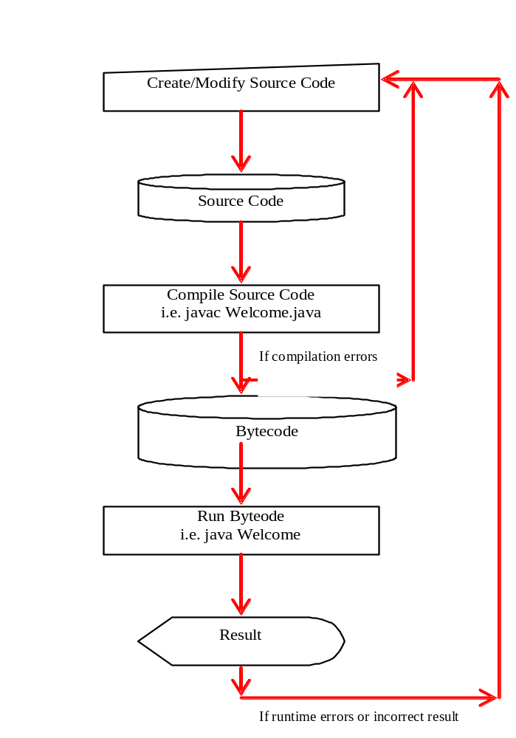
Creating and Compiling Programs
On command line
  javac file.java

Slide 47
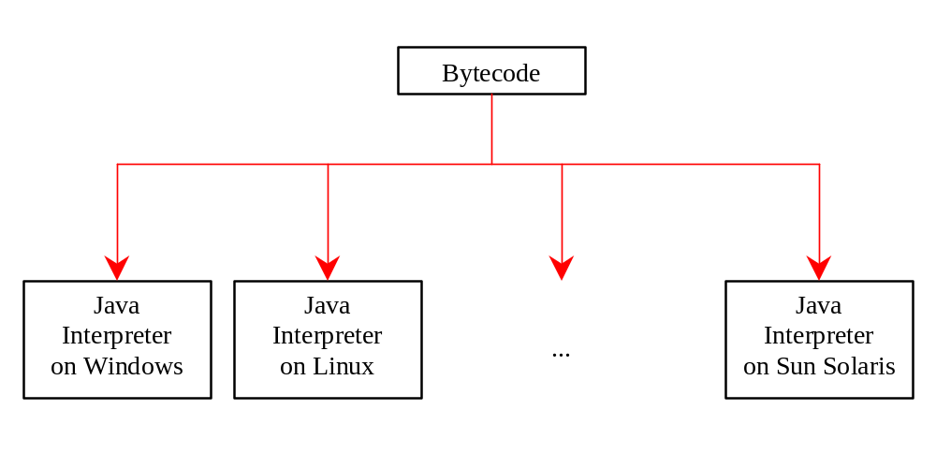
Executing Applications
On command line
  java classname

Slide 48
How to install JAVA
1. Visit java.sun.com.
2. Find a link to download the Java SE 6 (the Java Standard Edition, version 6).
If you find some other version. Just make sure that you have a version numbered 6 or higher.
3. Download the JDK, not the JRE.
To create your own Java programs, you need more than the JRE. You need the entire JDK.
4. Double-click the icon of the downloaded file and follow the wizard’s instructions for installing the JDK.

Slide 49
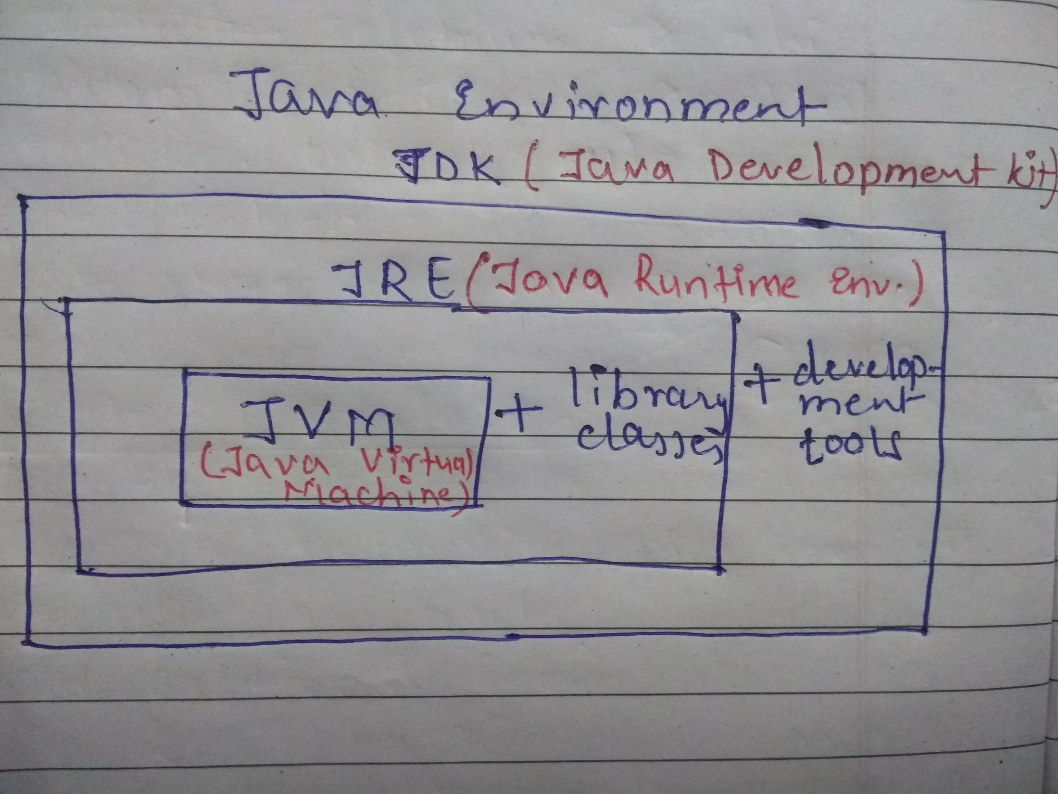
JDK(JAVA Development Kit)

